Slide 1
Paying for College

Slide 2
Financial Aid Terms
COA – cost of attendance; varies by institution
EFC – expected family contribution; number derived from the FAFSA and used to determine need based aid eligibility
FAFSA – Free Application for Federal Student Aid
FSA ID – usernames/passwords created by student AND parent to electronically sign the FAFSA
SAR – student aid report; summary of FAFSA information
Grant – free money based on need
Loan – money borrowed that must be paid back with interest
Scholarship – free money awarded on the basis of merit, skill, or unique characteristic
Verification – random “audit” of FAFSA
Work study – money received from on campus employment

Slide 3












Notes:
So why are we here… well, we are here to talk about college.. Right? And when I use the term “college”, Im not just talking about one specific type of school…The term college is a general one that encompasses a wide range of higher-education institutions, including those that offer certificate programs like a TCAT, two-and four-year schools both public & private (like Roane State or UT Knoxville) , as well as out of state schools (Like Norte Dame). (so whats a TCAT? I’m glad you asked –True story: My oldest son, super smart, graduated 5th in his class which is pretty good out of a class of 200 right? Wasn’t really sure what he wanted to do with his life… went to UT Martin and pretty much majored in “party 101”.. So long story short-lost his lottery and really wasn’t sure what he wanted to do with his life… Well Tennessee College of Applied Technology enters the picture or TCAT- they offer programs like Electro-Mechanical Technology , Drafting, Welding, and many many more. In 12 months my son completed the program and was immediately hired by Nissan. I wont lie.. Starting pay at Nissan is pretty nice… So please understand that when we refer to “college”, its for any post secondary education.

Slide 4
2020-21 FAFSA
Available October 1, 2019
www.fafsa.gov (VERY IMPORTANT!)
Student AND parent will create FSA ID usernames/passwords (fsaid.ed.gov) to sign electronically
Student and parent will submit FAFSA using IRS Data Retrieval Tool to upload 2018 tax information

Slide 5
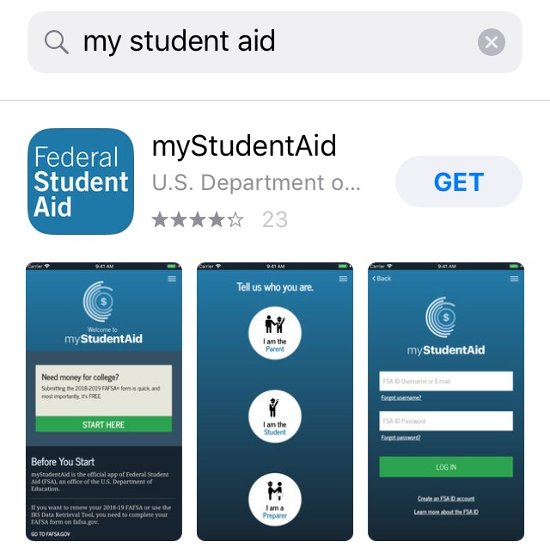
FAFSA Reminders
Complete website redesign (2018)
App launched in 2018 for Android/Apple

Slide 6
FAFSA Checklist
Student’s Social Security number
Parent(s)’ Social Security number(s)
Student’s driver’s license number if you have one
2018 tax information for student and parent(s)
  Most parents/students will upload their 2018 tax information using the IRS Data Retrieval Tool via FAFSA.
Records of your untaxed income, such as child support and veterans noneducation benefits for student and parent(s)
Information on checking and savings account balances; investments; and business and farm assets

Slide 7
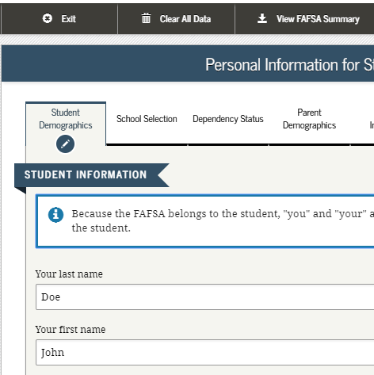
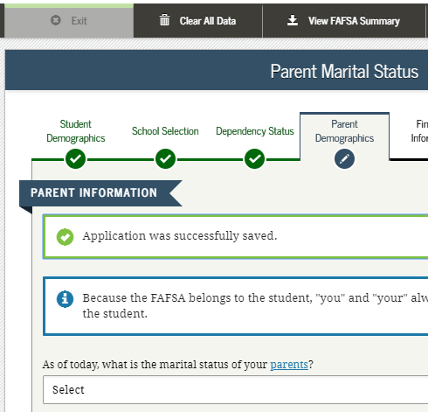
Student Demographic Information
Student & Parent
Notes:
2017-18 “Student Demographic Information” page.

Slide 8
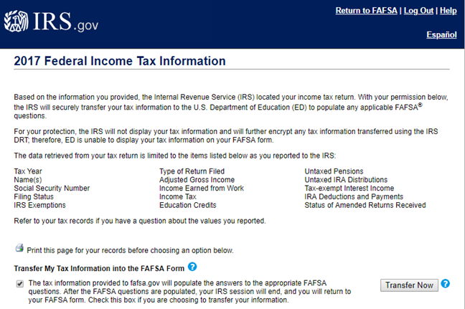
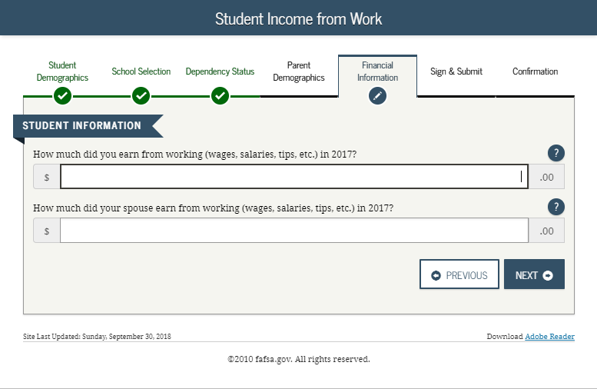
Income from work
Parents who file jointly will need W2s to manually enter income from work

Slide 9
IRS Data Retrieval Tool
Student/parent will be unable to see their information displayed upon transfer to FAFSA
Joint filers will now be required to enter their “income earned from work” manually (i.e. 2018 W2s)

Slide 10
FAFSA Investments
Include
Rental property
Trust funds
Money market funds
Mutual funds
Certificates of deposit
Stocks
Stock options
529 college savings plans
UTMA/UGMA accounts
Do NOT Include
Primary place of residence
401[k] plans
Pension funds
Annuities
Non-education IRAs

Slide 11
Student Aid Report
Important for students to review their Student Aid Report (SAR)
Problems will be addressed on first page
Verification indicator is an * right after the Expected Family Contribution (EFC)

Slide 12
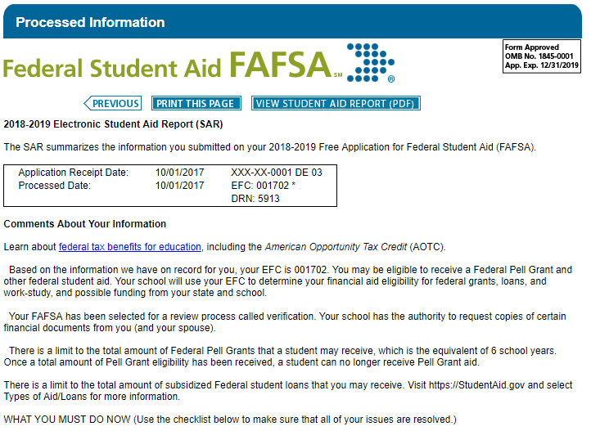
Note the asterisk and
the sentence regarding
verification.

Slide 13
Reasons for FAFSA
HOPE Scholarship & TN Promise
Student & PLUS loans
Because the college said so (i.e. institutional aid)

Slide 14
TCAT
Wilder- Naifeh
$667 per trimester
TSAA
$333 per trimester
TN Promise
Award amount varies
Pell Grant
$2,065 per trim’ster max (2019-20)
0 – 5576 EFC
Need based (2019-20)
0 – 2,100 EFC
February 1
Certificate/
Diploma TCAT
Last dollar to offset tuition
Need
Merit
Neither
Notes:
Red fill – program is need-based (i.e. income based). No fill – program is neither need-based nor merit-based.

Slide 15
TN Community College
HOPE Scholarship
$1,500 per semester
TN Promise
TSAA
$650 per semester
Award amount varies
Pell Grant
$3,097 per semester max (2019-20)
0 – 5576 EFC
Need based (2019-20)
0 – 2,100 EFC
February 1
21 ACT/SAT or 3.0 GPA*
Last dollar to offset tuition
Need
*All courses calculated on a 4.0 scale
per the Uniform Grading Policy
Merit
Neither
Notes:
Red fill – program is need-based (i.e. income based). Blue fill – program is merit-based (ACT or GPA). No fill – program is neither need-based nor merit-based.

Slide 16
TN Promise Checklist
Apply to the Tennessee Promise program at www.TNPromise.gov by November 1, 2019
Complete 2020-21 FAFSA at www.FAFSA.gov by February 1, 2020
Attend spring mandatory meeting as coordinated by partnering organization
Complete 8 hours of community service between November 2, 2019 – July 1, 2020

Slide 17
TN Promise (Semester)
Examples | A | B | C
Tuition | $2,250 | $2,250 | $2,250
HOPE/Pell/TSAA | -$3,250 | -$1,500 | $0
Gap | $0 | $750 | $2,250
TN Promise | $0
Tuition | $0
$750
$0
$2,250
$0

Slide 18
TN 4-yr public
HOPE Scholarship
$1,750/$2,250 per semester
TSAA
$1,000 per semester
Pell Grant
$3,097 per semester max (2019-20)
0 – 5576 EFC
Need based (2019-20)
0 – 2,100 EFC
February 1
21 ACT/SAT or 3.0 GPA*
*All courses calculated on a 4.0 scale
per the Uniform Grading Policy
Need
Merit
Notes:
Red fill – program is need-based (i.e. income based). Blue fill – program is merit-based (ACT or GPA).

Slide 19
TN 4-yr private
HOPE Scholarship
$1,750/$2,250 per semester
TSAA
$2,000 per semester
Pell Grant
$3,097 per semester max (2019-20)
0 – 5576 EFC
Need based (2019-20)
0 – 2,100 EFC
February 1
21 ACT/SAT or 3.0 GPA*
*All courses calculated on a 4.0 scale
per the Uniform Grading Policy
Need
Merit
Notes:
Red fill – program is need-based (i.e. income based). Blue fill – program is merit-based (ACT or GPA).

Slide 20
HOPE Renewal
24 attempted hour benchmark
72 attempted hour benchmark
2.75 – 2.99 cumulative GPA & 3.0 semester GPA
3.0 cumulative GPA or
2.75 cumulative GPA
48 attempted hour benchmark
2.75 cumulative GPA
96 attempted hour benchmark
3.0 cumulative GPA or
2.75 – 2.99 cumulative GPA & 3.0 semester GPA

Slide 21
Out-of-state
Pell Grant
$3,097 per semester max (2019-20)
0 – 5576 EFC
Need based (2019-20)
Academic Common Market
Out-of-state tuition assistance for programs not offered in TN
acm.coordinator@tn.gov
Need
Merit
Neither
Notes:
Red fill – program is need-based (i.e. income based).

Slide 22
HOPE Supplements
GAMS
Aspire Award
$250/$750 per semester
$500 per semester
29 ACT/SAT & 3.75 GPA*
Parents AGI ≤$36,000
*All courses calculated on a 4.0 scale
per the Uniform Grading Policy
Need
Merit
Notes:
Red fill – program is need-based (i.e. income based). Blue fill – program is merit-based.

Slide 23
HOPE Access
HOPE Access
18-20 ACT & 2.75-2.99 GPA* & AGI≤$36K
$875/$1,250 per semester
For students who do not qualify for the HOPE Scholarship at graduation, but satisfy…
*All courses calculated on a 4.0 scale
per the Uniform Grading Policy
Need & Merit
Notes:
Purple fill – program is both merit- & need-based.

Slide 24
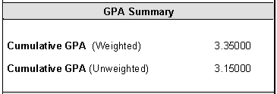
HOPE/GAMS/Access GPA
HOPE GPA (4.0 scale) = most districts’ unweighted GPA

Slide 25
Federal Aid
Subsidized Stafford
Unsubsidized Stafford
Parent PLUS
4.53% fixed (2019-20)
Interest does not accrue initially
4.53% fixed (2019-20)
Interest does accrue
7.08% fixed (2019-20)
Interest does accrue
Loan

Slide 26
Federal Loan Limits

Slide 27
Senior Year Checklist
Fall Semester
Take and retake the ACT/SAT
Apply to several colleges (admissions, institutional aid, etc) and utilize their net price calculators
Student AND parent will create FSA IDs (fsaid.ed.gov) to...
Complete 2020-21 FAFSA available October 1, 2019
Spring Semester
Complete local/private scholarship applications
Review college acceptances, compare financial aid packages, ask questions, and follow up as needed

Slide 28

utpromise.tennessee.edu
A new scholarship guaranteeing free tuition and mandatory fees Eligible students must meet the following criteria:
Family household income under $50,000/year
Receive the Tennessee HOPE scholarship and be admitted as an undergraduate to any UT campus
Complete 8 volunteer service hours each semester and participate in mentoring
APPLY FOR UT PROMISE BY NOV. 1
Instructions on how to apply for UT Promise for fall 2020—and answers to questions, such as who is eligible and what costs are covered—are available at: utpromise.tennessee.edu
Notes:
utpromise.tennessee.edu
Moving You Closer to a Debt-Free Degree
MEMPHIS MARTIN CHATTANOOGA KNOXVILLE

Slide 29


Slide 30



Slide 31
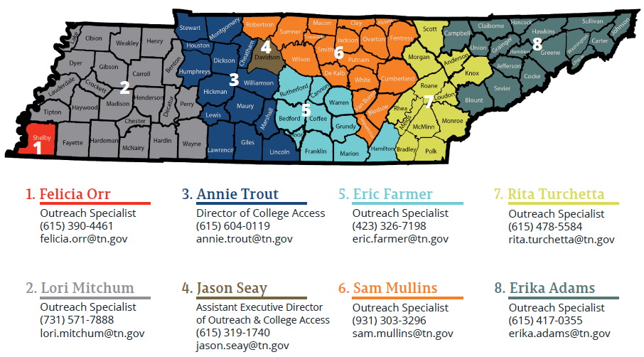
Outreach Division

Slide 32






@TNHigherEd
@TNReconnect
@TNPromise
Questions?
Rita.turchetta@tn.gov

Slide 33

tnedequity.org

Slide 34
Cost of Attendance
 | 2-yr Public | 4-yr Public | TN Private; Out of State
Tuition/Fees | $4,300 | $12,834 | $46,500
Room/Meals | N/A | $10,696 | $15,584
Books/Supplies | $1,200 | $1,598 | $1,294
Miscellaneous | VARIES | VARIES | VARIES
COA | $12,917 | $30,794 | $67,392
 | 2-yr Public | 4-yr Public | TN Private; Out of State
Tuition/Fees | $3,801 | $12,436 | $43,620
Room/Meals |  | $9,926 | $14,670

Slide 35

Four Parts of the EFC
Parent Contribution from Income
Parent Contribution from Assets
Parent Contribution (PC)
Student Contribution from Income
Student Contribution from Assets
Student Contribution (SC)
Expected Family Contribution (EFC)

Slide 36
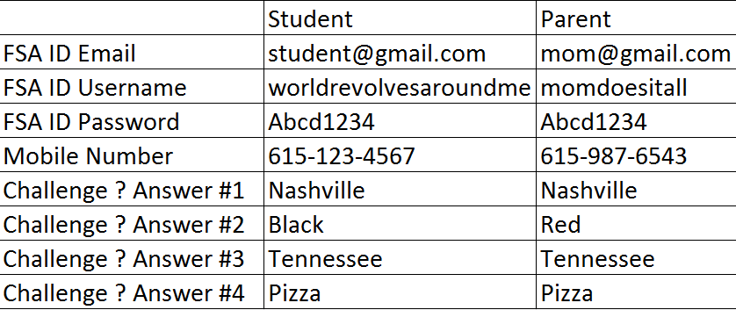
fsaid.ed.gov
Please record usernames, passwords, and challenge ? answers

Slide 37
Other Information
Ned McWherter Scholars
Fee Discount Program
CSS Profile

Slide 38
Foster Youth
HOPE Foster Grant (14+)
Chafee ETV Scholarship
TN Bright Futures (16+)

Slide 39
STEP UP Scholarship
Lipscomb University
University of Memphis
TigerLIFE
Union EDGE Program
Union University
IDEAL Program
University of Tennessee
UT Future
Vanderbilt University
Next Steps
Application deadlines: September 1 for Fall; February 1 for Spring; May 1 for Summer

Slide 40
TN Reconnect Checklist
Complete the TN Reconnect application at www.TNReconnect.gov.
Apply to community college, TCAT, or eligible TN Reconnect institution.
Submit the 2020-21 FAFSA at www.FAFSA.gov (deadline varies).
Enroll in a degree or certificate program at least part-time (6+ hours).

Slide 41

TSAC Student Portal
Students should review their state aid institution…

Slide 42
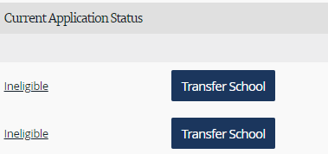
TSAC Student Portal
…if institution is incorrect, click “transfer school”…

Slide 43
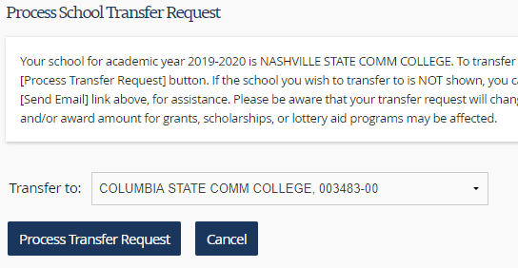
TSAC Student Portal
Select college from the pull-down menu.
Click “process transfer request.”
1
2

Slide 44
Common FAFSA Issues
Social Security Number
Name (must match Social Security card)
Date of birth
Missing signatures

Slide 45
Common FAFSA Issues
Grade level: 1st year graduate/ professional
Degree: Graduate/ professional
Income and tax manually reported as same number
Parent and student report same income

Slide 46
Dual Enrollment Grant
11th Fall
$500 (1)
$500 (2)
11th Spring
$200 (3)
$0 (4)
12th Fall
$300 (5)*
$300 (6)*
12th Spring
$300 (7)*
$300 (8)*
*Subject to one-time HOPE Scholarship reduction

Slide 47
ACT
ACT TEST DATE | REGISTRATION DEADLINE | LATE FEE DEADLINE
September 14, 2019 | August 16, 2019 | August 30, 2019
October 26, 2019 | September 20, 2019 | October 4, 2019
December 14, 2019 | November 8, 2019 | November 22, 2019
February 8, 2020 | January 10, 2020 | January 17, 2020
April 4, 2020 | February 28, 2020 | March 13, 2020
June 13, 2020 | May 8, 2020 | May 22, 2020
July 18, 2020 | June 19, 2020 | June 26, 2020

Slide 48
SAT Scores
College Board is no longer sending TSAC test records due to PII concerns.
Counselors can manually enter SAT scores if needed or contact your TSAC Outreach Specialist.

Slide 49

Eligibility
A student must possess a valid SSN and be a U.S. citizen or an eligible noncitizen as defined by FAFSA…

Slide 50
Ineligibility
A student will NOT qualify for federal or state aid if he or she has…
  Been granted Deferred Action for Childhood Arrivals (DACA)
  A F1 or F2 student visa
  A J1 or J2 exchange visitor visa
  A G series visa (pertaining to international organizations)

Slide 51

DACA SSN Card

Slide 52
TN Community College
HOPE Scholarship
$1,500 per semester
TN Promise
TSAA
$650 per semester
Award amount varies
Pell Grant
$3,097 per semester max (2019-20)
0 – 5576 EFC
Need based (2019-20)
0 – 2,100 EFC
February 1
21 ACT/SAT*
Last dollar to offset tuition
Need
*Home school students must satisfy one-year enrollment requirement and some must have given notice to LEA
Merit
Neither
Notes:
Red fill – program is need-based (i.e. income based). Blue fill – program is merit-based (ACT or GPA). No fill – program is neither need-based nor merit-based.

Slide 53
TN 4-yr public
HOPE Scholarship
$1,750/$2,250 per semester
TSAA
$1,000 per semester
Pell Grant
$3,097 per semester max (2019-20)
0 – 5576 EFC
Need based (2019-20)
0 – 2,100 EFC
February 1
21 ACT/SAT*
Need
*Home school students must satisfy one-year enrollment requirement and some must have given notice to LEA
Merit
Notes:
Red fill – program is need-based (i.e. income based). Blue fill – program is merit-based (ACT or GPA).

Slide 54
TN 4-yr private
HOPE Scholarship
$1,750/$2,250 per semester
TSAA
$2,000 per semester
Pell Grant
$3,097 per semester max (2019-20)
0 – 5576 EFC
Need based (2019-20)
0 – 2,100 EFC
February 1
21 ACT/SAT*
Need
*Home school students must satisfy one-year enrollment requirement and some must have given notice to LEA
Merit
Notes:
Red fill – program is need-based (i.e. income based). Blue fill – program is merit-based (ACT or GPA).

Slide 55
HOPE Supplements
GAMS
Aspire Award
$250/$750 per semester
$500 per semester
29 ACT/SAT & See brochure*
Parents AGI ≤$36,000
Need
*Home school students must satisfy one-year enrollment requirement and some must have given notice to LEA
Merit
Notes:
Red fill – program is need-based (i.e. income based). Blue fill – program is merit-based.

